Slide 1
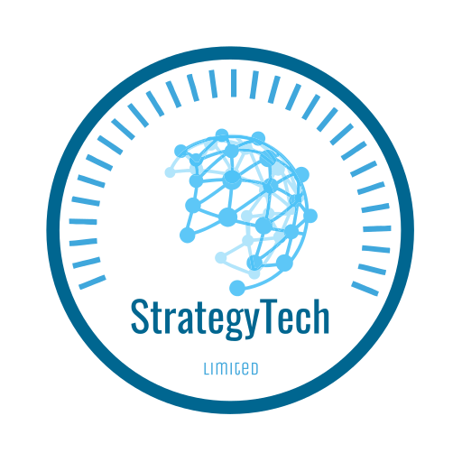

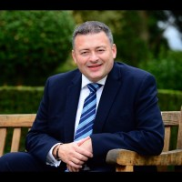
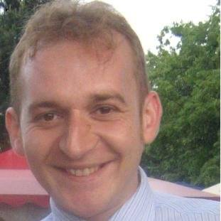

StrategyTech + Flowster / Oameni Sănătoși SRL
Stronger, together
Paul Gardner
Founder
StrategyTech Ltd
Bogdan Tiu
Founder
Flowster, OAMENI SĂNĂTOȘI Srl
‘Designing & Delivering digital benefits for over three decades’
Digital Transformation
Programme Management
Business Transformation
Board Advisory
Digital Dispute Resolution
‘A wealth of experience built over 20 years, with a proven track record in delivering Projects’
Planning & Definition
Risk Management
Resource Management
Monitoring & Control
Project Completion
© StrategyTech Ltd 2026

Slide 2
Who We Are
StrategyTech & Flowster
Combine over 20 years of experience in:
Digital Transformation
Programme Delivery
Enterprise Project Management
Transformation
Enabled
Listen
Plan
Deliver
Measure
© StrategyTech Ltd 2026

Slide 3

Our Integrated Value Proposition
Strategy + Digital Transformation + End-to-End Project Management = Measurable Business Impact
Identify the opportunities to improve
Research the Optimal Transformation path
Model the Return on Investment
Execute the transformation using our Reliable, predictable Project Expertise
Measure the impact on your organisation
© StrategyTech Ltd 2026

Slide 4





Services Portfolio
Digital Transformation
Identifying, Guiding & Optimising your organisation to maximise growth using Digital Transformation with Technology and Processes. From Strategy building to front-line delivery, achieve the results you need.
Process Optimisation
Organisations front & back-office Technology deployment. Unlocking processes optimisation. Delivery of projects and programmes for Transformation and Optimisation. From Customer Relationship Management to drive sales to Enterprise Resource Planning (ERP) ensuring your Communication and I.T. platforms, such as Finance and HR Systems are all optimised to reduce overheads.
Programme & Project Delivery
Planning & Delivering your organisations goals efficiently and professionally. Employing Strong Governance to ensure projects deliver to meet your needs.
Working with you
We can work as part of your management team on the board, through to delivering changes with the front-line teams to deliver the results and improvements you strive for. We have diverse, business wide experience in Marketing through to Sales and Product, so can advise you on a wide breadth of improvement areas open to Digital Optimisation in addition to wider, strategic M&A and investment appeal.
Our Team
Our team are highly experienced experts in running successful programmes which provide private sector investment returns as well as Public Service delivery. Operating at board level and being able to ‘roll up their sleeves’ for effective delivery. We understand your challenges and identify the opportunities for your growth, which can be delivered through our expert Programme and Project delivery.
© StrategyTech Ltd 2026

Slide 5
How we work with you
Strategy Definition
  Agree your OKR’s (Objectives and Key Results)
  Map the steps and investment parameters needed to achieve the ROI
Solution Design
  Identify the Digital opportunities and what they need to deliver
  Agree ‘how’ they will be delivered and ‘when’
  We will guide you on ‘what’ tools are needed
Implementation
  We will plan with you and agree resourcing profiles to ensure delivery
Monitoring & Control
  We align with you on measurement
  Ensure key decision makers are engaged
  Regular reporting to keep you in-tune with progress
Continuous Optimisation
  Digital Transformation doesn’t stop!
  We deliver, enabling the ROI, but keep our eyes and ears open for additional opportunities for you
  Self-realisation for many organisations happens as we & they progress and unearth non-compliance or process deviations
© StrategyTech Ltd 2026

Slide 6
Delivery & Governance Model
PMO Governance
Project Methodologies & Training
Project Performance Reporting
Project Capacity & Support
Project Resourcing
Project Health Checks & Audits
Portfolio Management
Enterprise Project Management Office (PMO)
  Risk & Quality Assurance
  KPI & Executive Dashboards
  Budget & Timeline Control
© StrategyTech Ltd 2026

Slide 7
Technology & Process Optimisation
Finance & HR Automation
Customer Intelligence
Product Roadmap
System Integration
Data-driven Decisions
© StrategyTech Ltd 2026

Slide 8
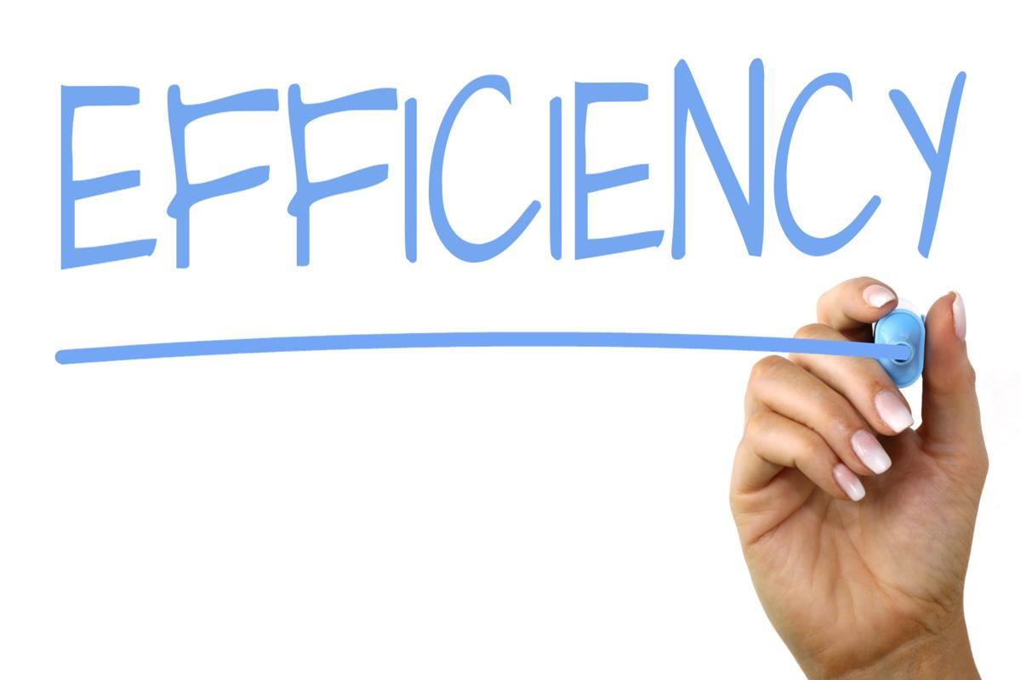
Business Benefits
Reduced Costs
Faster Delivery
Improved Quality
Regulatory Compliance
Scalable Operations
© StrategyTech Ltd 2026

Slide 9
Leadership Team
Paul Gardner
Founder
StrategyTech Ltd
Bogdan Tiu
Founder
Flowster, OAMENI SĂNĂTOȘI Srl
‘Successful outcomes and controls delivered for many customers’
Delivered 90+ IT & digital transformation projects (2012–2025)
Led programmes with budgets up to €2M+
Managed cross-border delivery in Austria, Belgium & Hungary
Ensured governance, risk management and delivery excellence
Experiences to help your organisation
Member of 4 x boards
Extensive Technology & Comms experience
UK, European & Global Leadership
  FTSE100 & Fortune 500
Worked for 5 x major SaaS vendors
Extensive Digital Delivery across hundreds of SaaS projects
© StrategyTech Ltd 2026

Slide 10






















Why partner with us?
One integrated team delivering strategy, technology, and execution for sustainable growth.
© StrategyTech Ltd 2026

