Slide 1
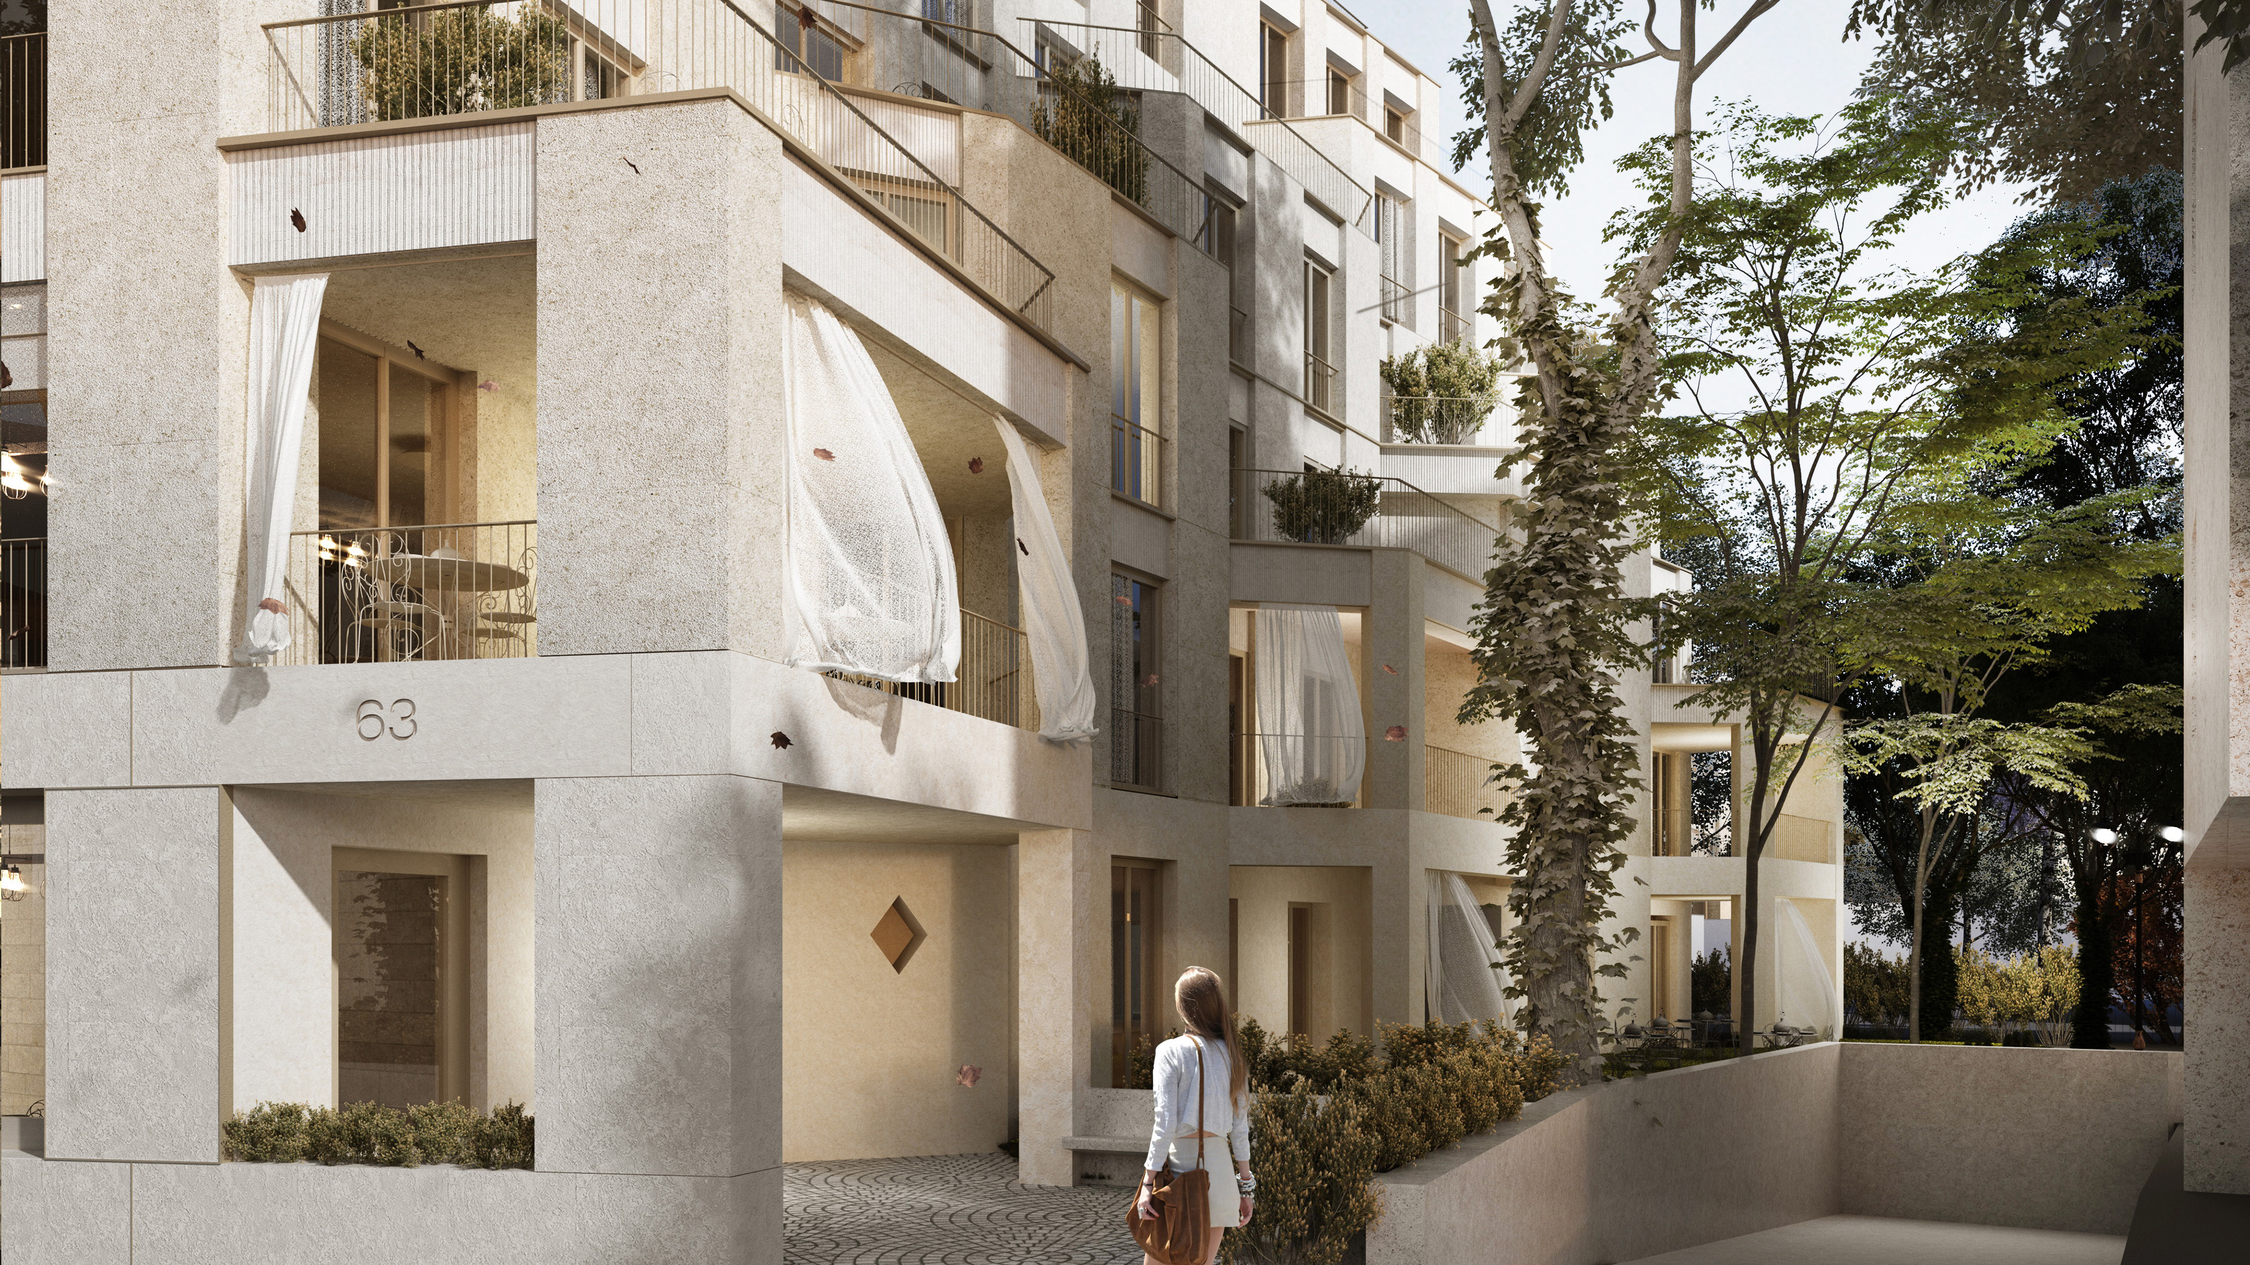


Voievozi 63
Legacy for future generations

Slide 2
Exclusive Location Facing Calea Victoriei, Bucharest
Key Highlights:
Location, location, location:
  Calea Victoriei is the most prestigious and historical avenue in Bucharest, known for its elegant architecture, curtural significance, and vibrant atmosphere;
  This land is situated in the heart of the city center, surrounded by iconic landmarks as Vernescu Palace, Nicolae Iorga Park, luxury boutiques, fine dining and art galleries, making it an ideal spot for high-end developments.

Slide 3
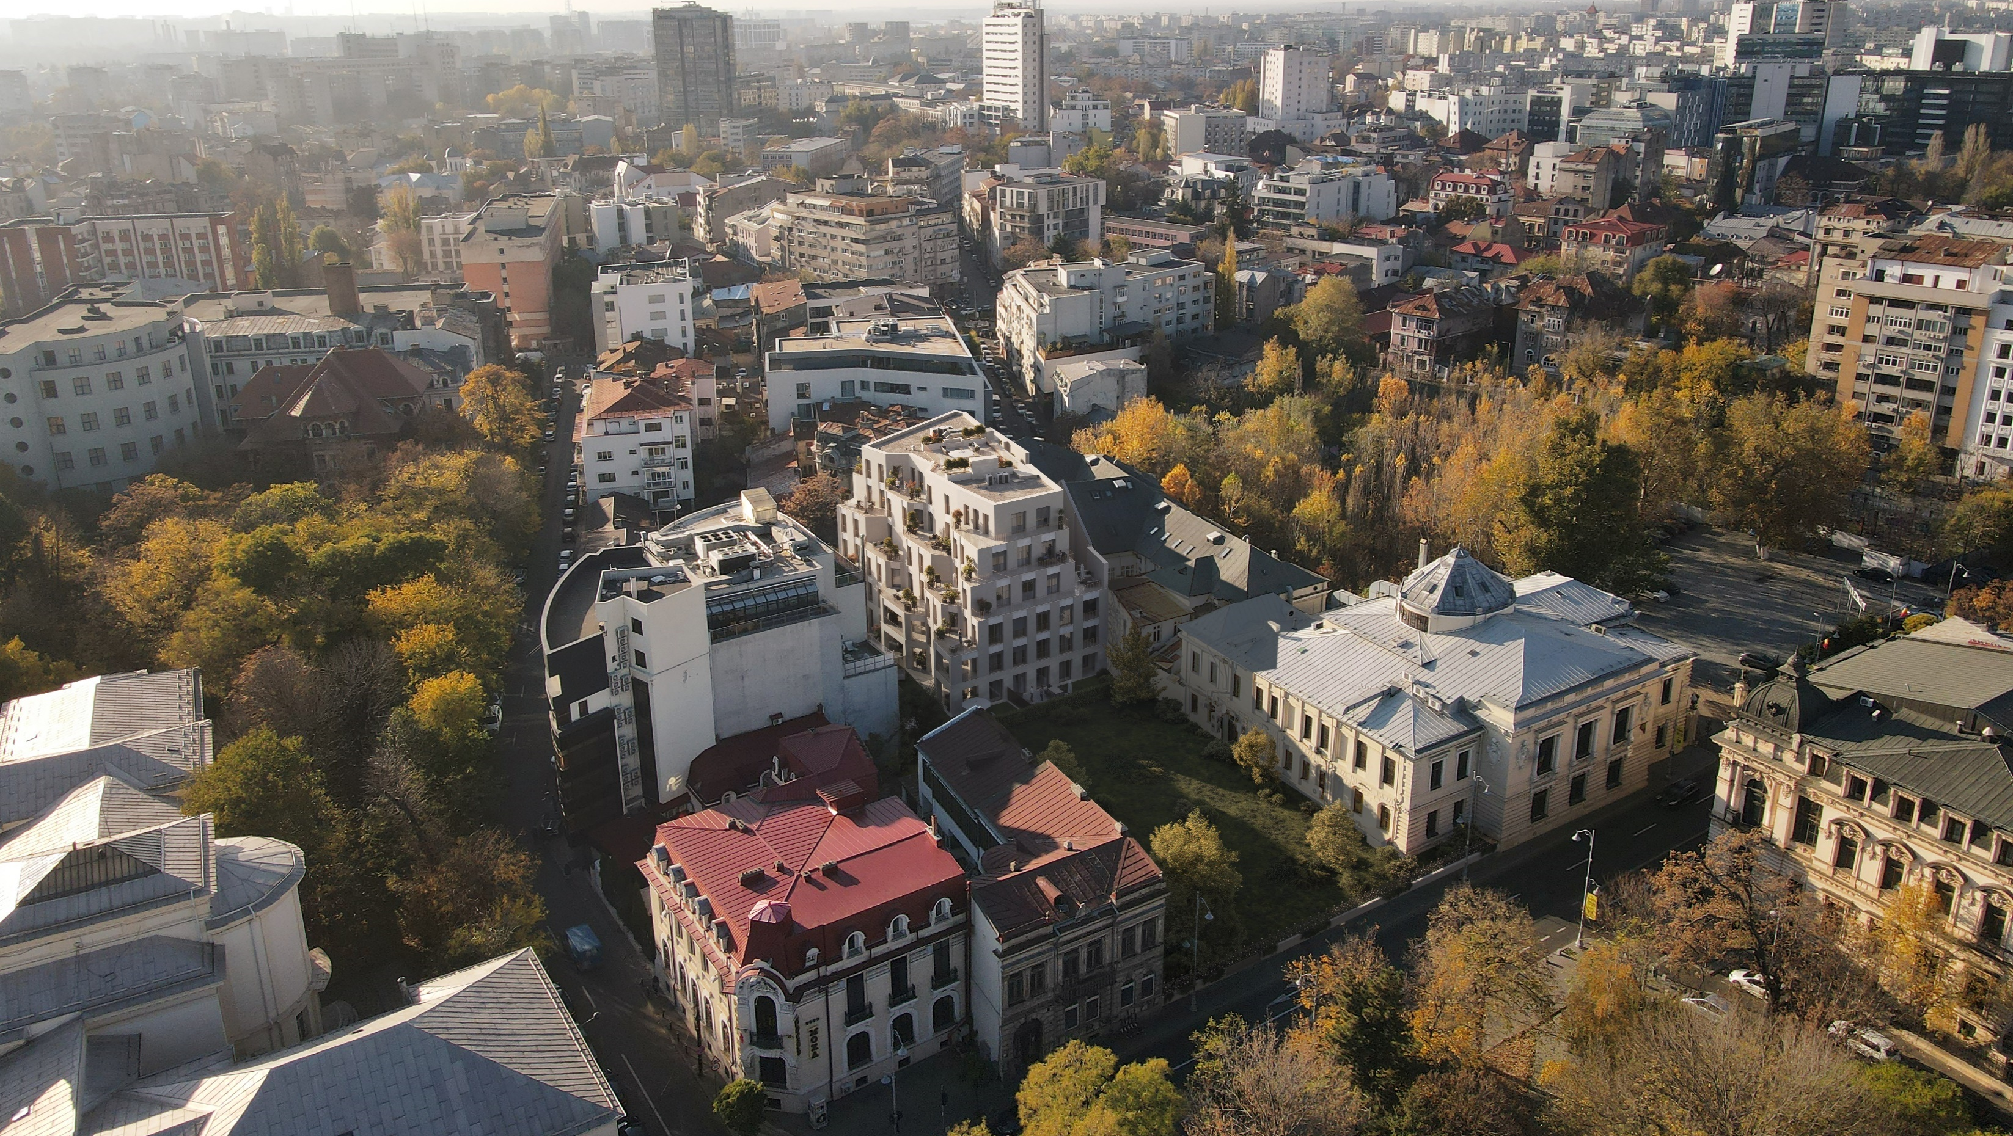

Slide 4
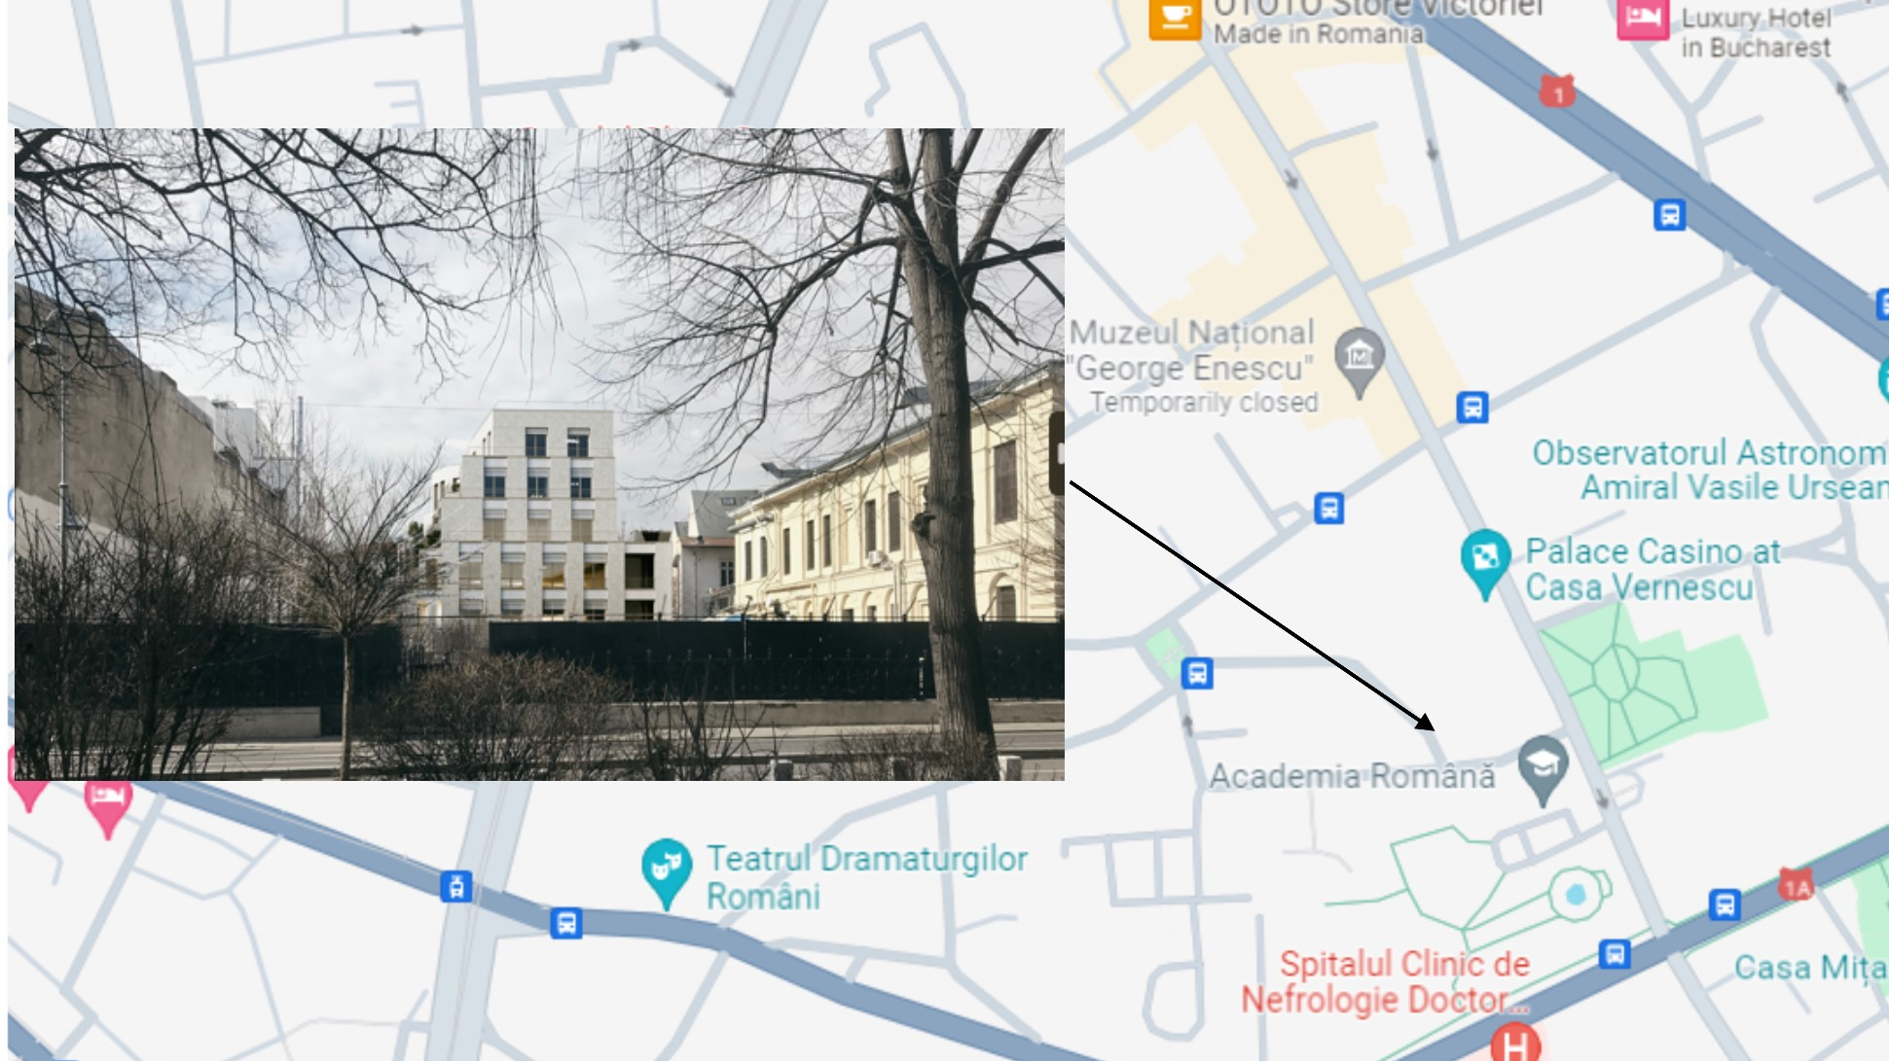
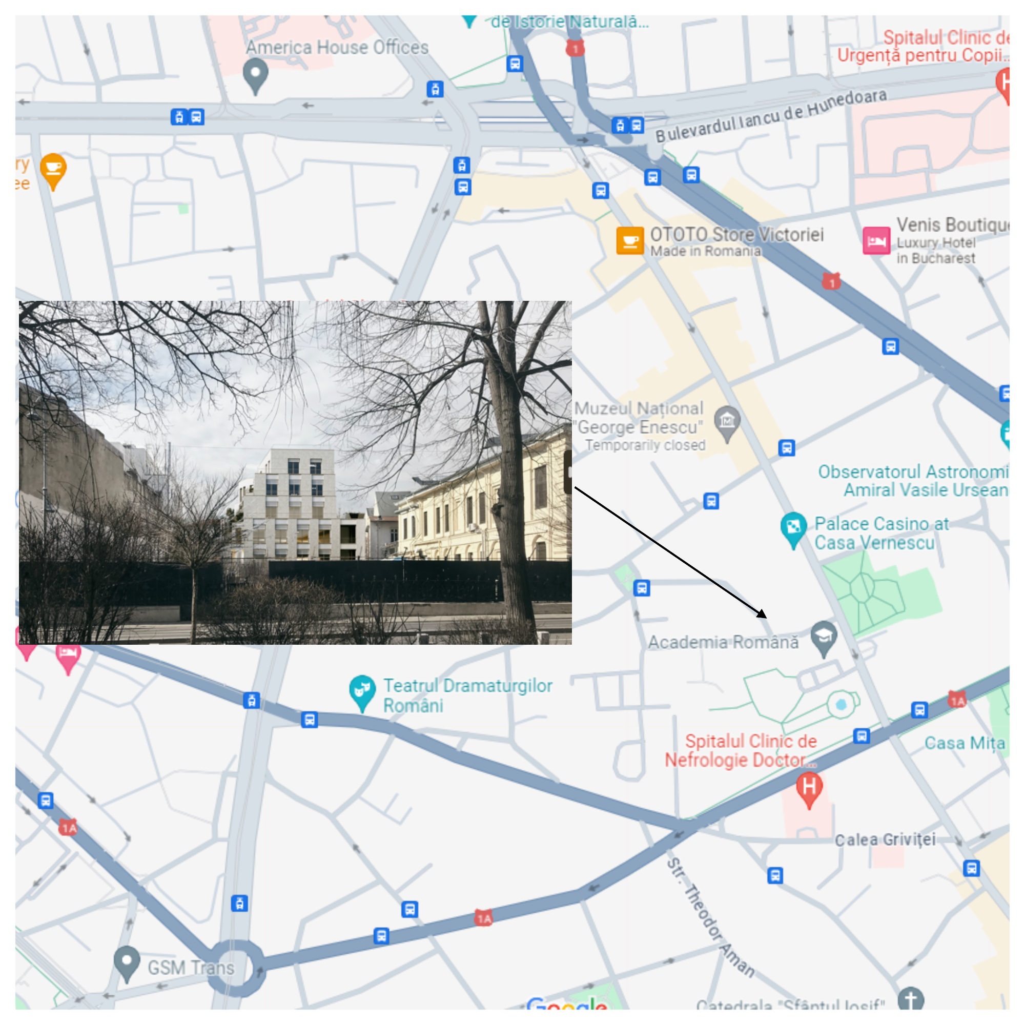
Prime Land Opportunity on Calea Victoriei, Bucharest

Slide 5
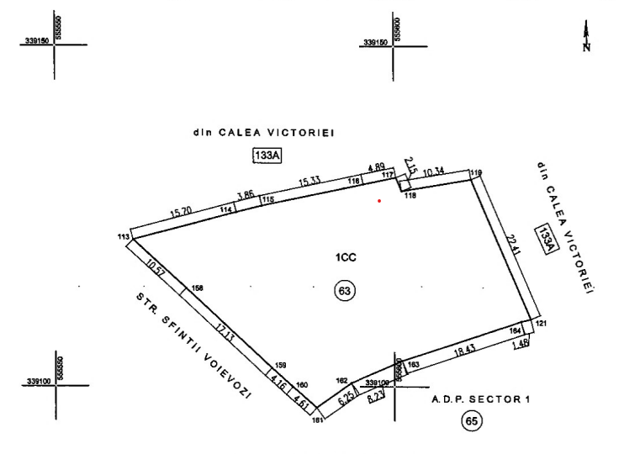
Voievozi 63 - Building Permit Ready!
Key Highlights:
2. Size and Zoning:
  The land spans 1,142.00 sqm, located on 63 Sfintii Voievozi Street, offering ample space for a variety of development projects;
  Zoned for mixed-use (residential & commercial areas), Building Permit was issued in June 2021;
  25 apartments, GF commercial premises and community areas;
  2UG + GF + 5 Floors, 32 underground parking places & storage areas available;
  Total built area aboveground; 4,021.00 sqm, including loggias & terraces

Slide 6

Voievozi 63 – Designed by
Key Highlights:
3. Architectural possibilities:
  Imagine the impact of creating a landmark development that complements the historical charm of Calea Victoriei while offering modern amenities and luxury living or commercial spaces.
  Our partner, ADN Birou de Arhitectura, worked closely with us to bring our vision to life, ensuring a distinctive and attractive addition to Bucharest’s skyline and they will always provide you support during the project development.

Slide 7
Voievozi 63 – Investment potential
Key Highlights:
4. Investment Potential:
  Bucharest’s real estate market is experiencing significant growth, particularly in prime locations like Calea Victoriei.
  The value of properties in this area has steadly increased, presenting a lucrative opportunity for investors looking to capitalize on the city’s booming economy and tourism.
5. Accessibility:
  With excellent transportation links, including metro stations and major roads, accessing and navigating the city from this location is convenient for residents, employees and visitors alike.
  The proximity to key business districts and cultural attractions ensures a steady flow of foot traffic and visibility for any establishment on this land.

